Slide 1

June 2, 2026
AI-Driven Energy Forecasting for Cost and Carbon-Aware Industrial Scheduling
Group 15 Furkan Kartal, Cansu Koçer, Feyza Aydınalp, Umut Emre Çakır

Slide 2


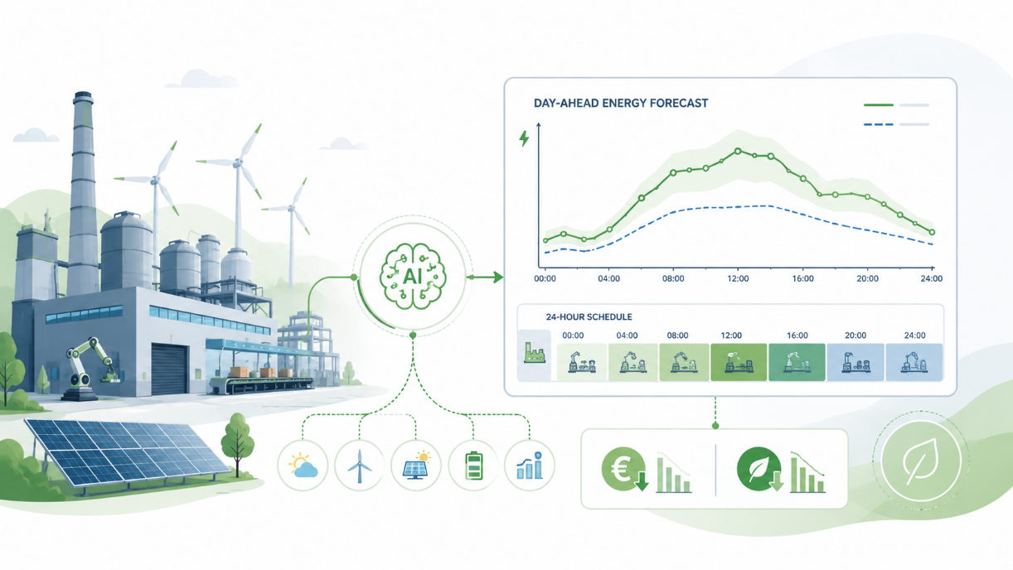

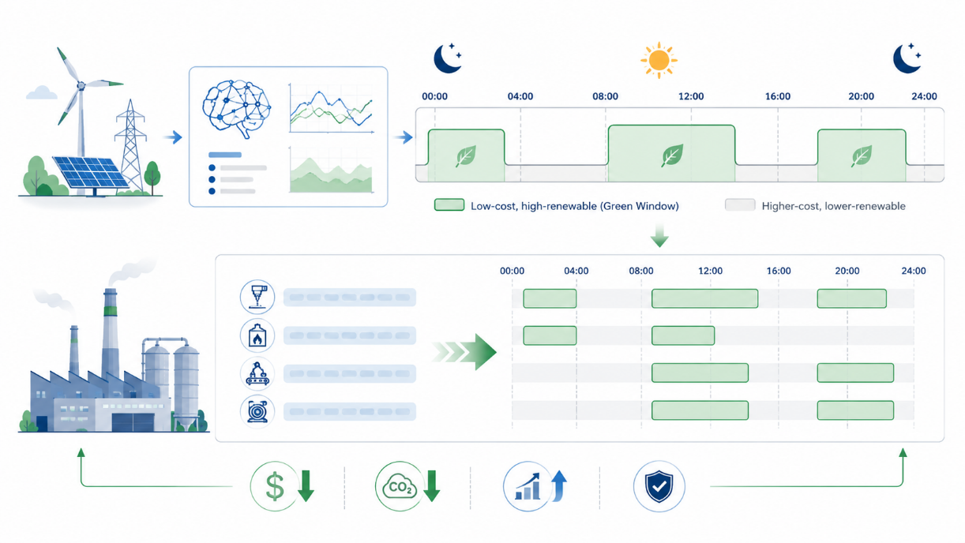
Background
Green Windows is an AI-driven energy forecasting and scheduling system designed for industrial facilities.
The project predicts 24-hour day-ahead energy prices and uses these predictions to identify suitable “Green Windows” for production scheduling.
The main purpose is to support cost-efficient and carbon-aware industrial operations by scheduling energy-intensive tasks during lower-cost and higher-renewable periods.
This problem is important because industrial energy consumption creates both financial pressure and environmental impact; therefore, smarter scheduling can provide practical business value.

Slide 3
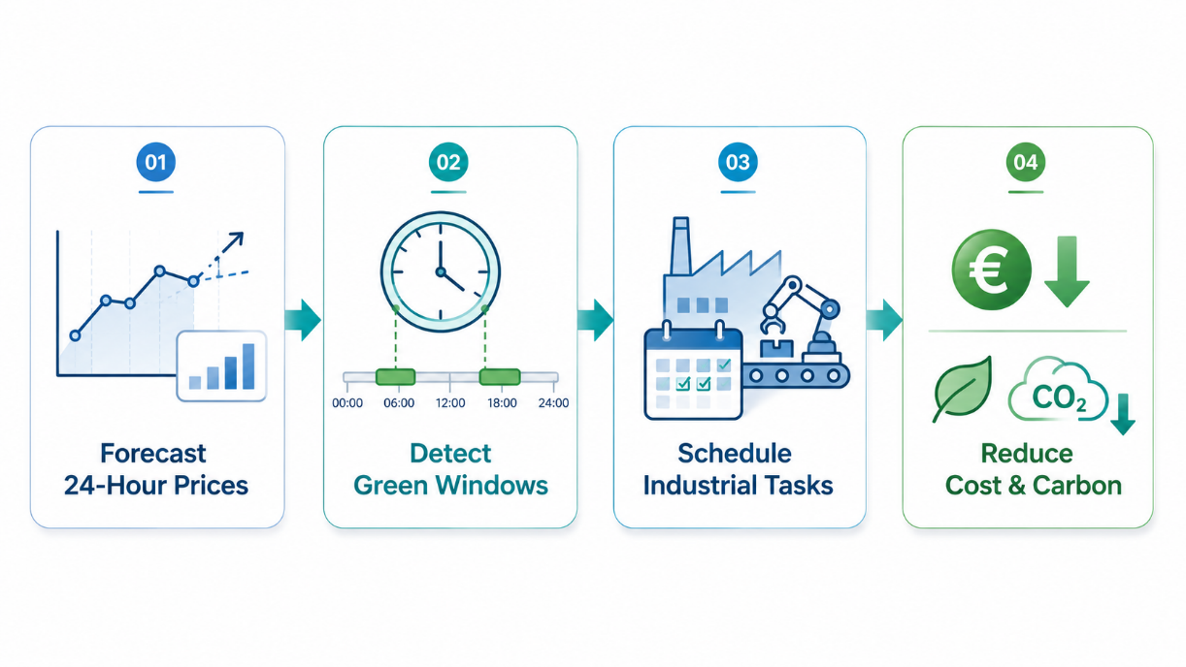
Objectives
Develop an AI-driven day-ahead energy price forecasting system.
Use machine learning predictions to identify “Green Windows” for industrial scheduling.
Optimize the timing of energy-intensive factory tasks based on predicted electricity prices.
Support industrial operations with a cost-efficient and carbon-aware scheduling approach.

Slide 4




SDG Relation
The Green Windows project supports sustainable industrial energy planning by combining machine learning-based energy price forecasting with cost and carbon-aware scheduling.
It is mainly related to:
SDG 7 – Affordable and Clean Energy: identifying low-cost and high-renewable energy periods.
SDG 9 – Industry, Innovation and Infrastructure: using AI-driven forecasting and scheduling for industrial operations.
SDG 12 – Responsible Consumption and Production: improving the timing of energy-intensive production tasks.
SDG 13 – Climate Action: supporting carbon-aware decision-making in industrial scheduling.

Slide 5

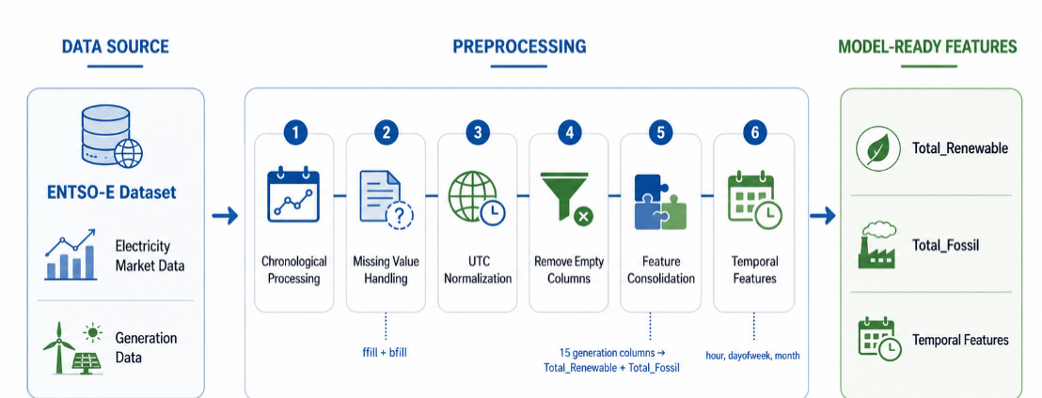
Data
The project uses the ENTSO-E energy dataset, including electricity market and generation-related data for day-ahead energy price forecasting.
Preprocessing Steps
The dataset was processed chronologically to preserve the time-series structure.
Missing values were handled using forward-fill and backward-fill.
The date index was converted to UTC to manage daylight saving time differences.
Empty columns were removed before missing value handling.
Generation-related columns were consolidated into Total_Renewable and Total_Fossil.
Temporal features such as hour, dayofweek, and month were added.

Slide 6

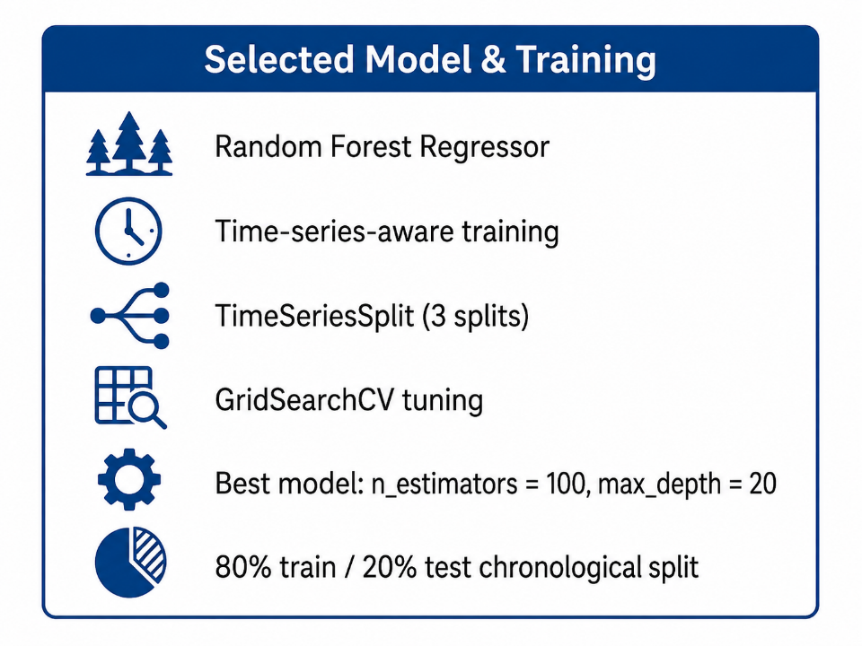
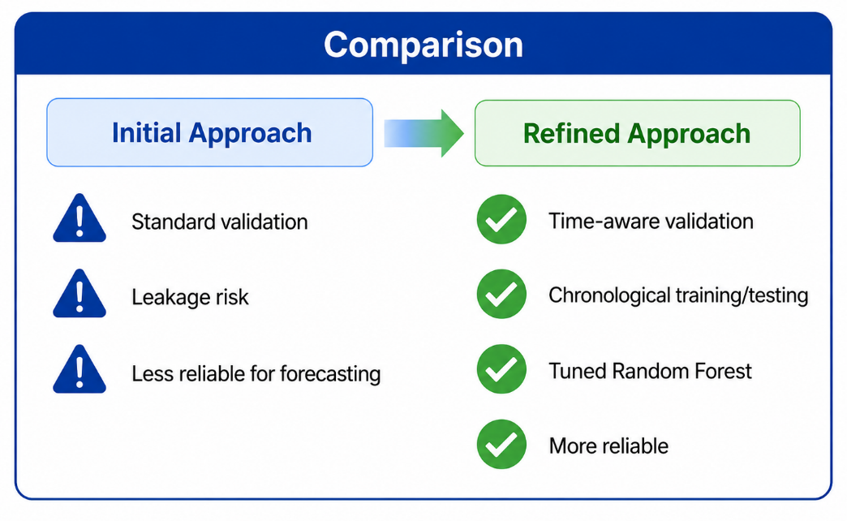
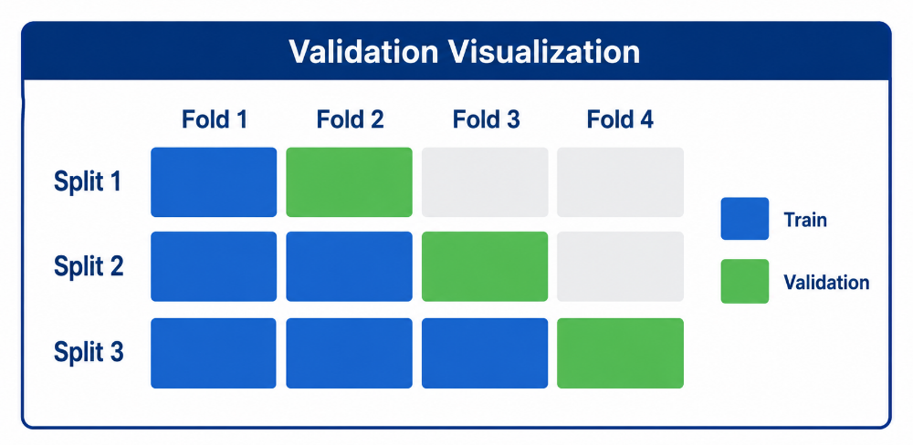

Model Selection and Training/Testing

Slide 7
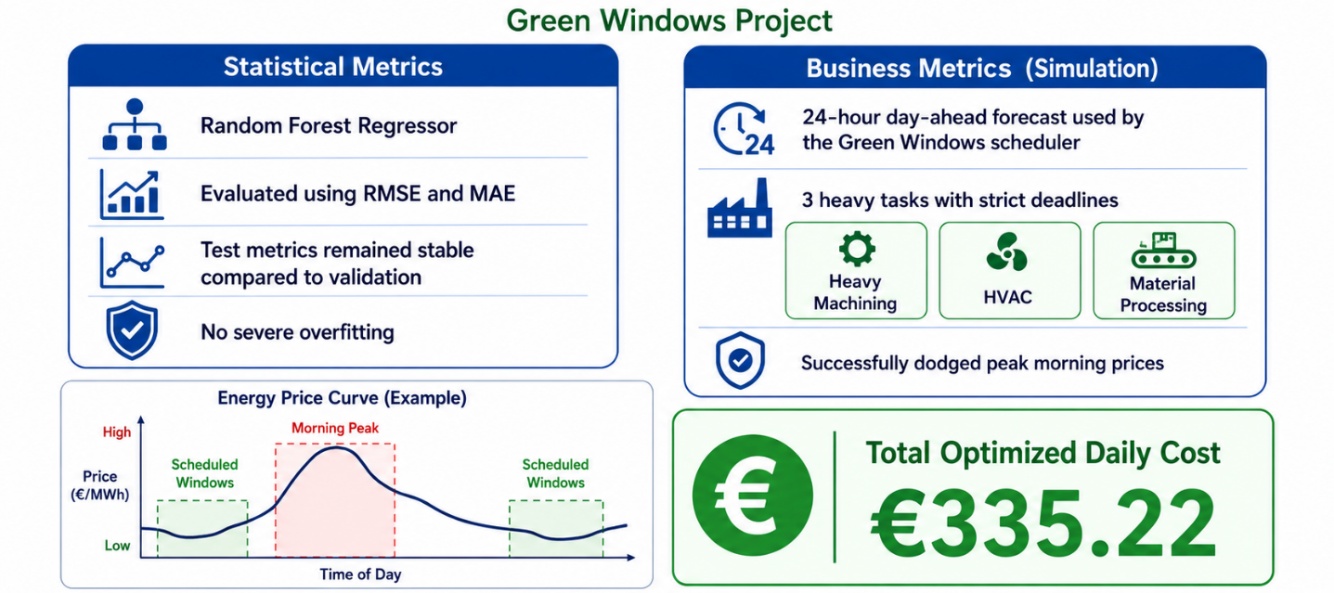
Evaluation Results
The refined Random Forest model was evaluated using RMSE and MAE.
Test results remained stable compared to validation, indicating no severe overfitting.
The 24-hour day-ahead forecasts were used by the Green Windows scheduler.
The scheduling simulation included 3 heavy industrial tasks: Heavy Machining, HVAC, and Material Processing.
Total Optimized Daily Cost: €335.22
The system successfully avoided peak morning prices and translated ML predictions into practical scheduling value.

Slide 8
Deployment
Result of Deployment. Short video would be better

Slide 9
Thank you!

